Slide 1
Treasury Onboarding Survey Results
AFPA Summit
June 11, 2014

Slide 2
Agenda
Treasury Strategies Survey: Paperless Onboarding
  Impact on Customer Satisfaction
  Implementation Pain Points
  Improving Implementation
  Using Technology
  Key Takeaways
What Should Paperless Look Like?
  Overview
  Benefits
  Results – Case Study
Q&A

Slide 3

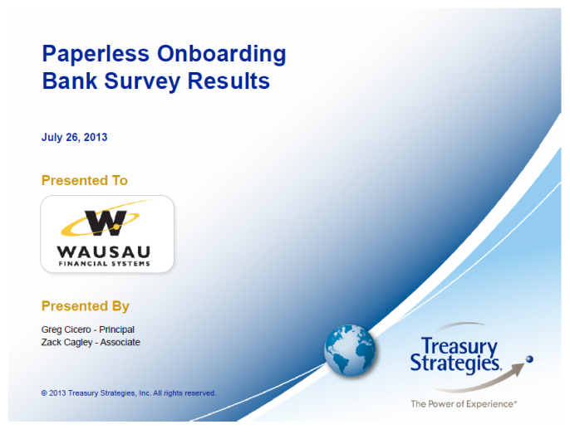
Treasury Strategies Survey
Commissioned study with TSI in July 2013
Gain a better understanding of the impact of the complexities and inefficiencies related to treasury onboarding
19 Banks and 20 Corporations responded
Titles included head of Treasury Management, Implementations, Product Management and Sales
Corporations $500M+ in revenue; Banks $5B+ in assets
Titles included Treasury Manager, Controller and Treasurer

Slide 4
Satisfaction With TM Onboarding
Corporations feel there’s room for improvement in their bank’s TM Onboarding process.
Q: How satisfied are you with the time it takes your bank to implement a new service?
Small corporations are less satisfied with the time it takes to implement a new service
The more complex the service, the less satisfied corporations are with the process
Corporations ($2B+) Corporations ($100M - $2B)
(Scale: 5 = Very Satisfied 1= Very Dissatisfied)
Notes:
Simple: (e.g., account opening)
Moderate: (e.g., basic lockbox, ACH, wire, etc.)
Complex: (e.g., lockbox with data transmission)

Slide 5
Banks Also See Opportunity to
Streamline and the Rewards are Great
90% of banks believe there is opportunity to accelerate revenue by shortening implementation cycle time.
Q: Is there opportunity to accelerate revenue by shortening implementation cycle time?
Banks (Assets $5B - $100B)
Banks (Assets $100B+)

Slide 6
Banks Also See Opportunity to
Streamline and the Rewards are Great
If the implementation process is shortened, almost 70% of banks believe it would free up their sales force to generate more sales.
Q: Will improving the implementation process free up your sales force to generate more sales?

Slide 7
Currently, the Onboarding Process is Often Painful
  Corporations are experiencing pain in every area listed below more than ½ the time:
Lack of clear view into implementation status
Poor communication with bank
Too many paper forms
Implementation process too lengthy
Redundant information requested by bank

Slide 8
Which Services Hurt the Most?
  Retail and Wholesale Lockbox solutions are most painful to implement. They generally have the longest implementation times.
Q: Which services are the most painful to implement?
(Scale: 5 = Very Painful / Difficult 1 = Little Pain)

Slide 9
Corporations Blame Their Pain on Banks
  Corporations say their greatest pain points derive from bank deficiencies rather than internal issues.
Q: Describe your greatest implementation pain points.

Slide 10
Paper is the Greatest Challenge
Q: How often do you experience the following pain points?
(Scale: 5= Very Often 1= Not Often at all)

Slide 11
Banks Need Help Managing/Gathering Documents
  “Outdated home-grown platform used today. No workflow capabilities, no doc image retention, virtually zero status reports.”
Q: Describe your greatest implementation pain points.

Slide 12
Better Communication is Necessary
  Corporations experience poor communication with their banks more than 50% of the time throughout the implementation process.
Q: How often do you experience poor communication with your bank?
(Scale: 5= Very Often 1= Not Often at all)

Slide 13
How Can Satisfaction Be Improved?
  Corporations have high expectations. All aspects of the
  onboarding process are important to them.
Q: Rate the following implementation qualities.
(Scale: 5= Very Important 1= Not Important)

Slide 14
Implementation Affects Future Business
  Corporations rated the TM Onboarding process a 3.8+, as having a substantial impact on the initial sale as well as impacting their future buying behavior.
Q: How important is implementation to winning business and what impact does it have on your buying decision?
Implementation, overall, has a larger impact on winning business and future buying decisions for small corporations.
Large corporations are more likely to base future buying decisions on how well their initial implementation went.
Corporations ($2B+) Corporations ($100M - $2B)
Chart based on a scale from 1-5
(5 = very strong impact, 1 = little impact)

Slide 15
What’s Missing in Banks’ Technology?
  Banks $100B+ have more sophisticated tools, but are they using them? Mid-sized banks need to catch up. No respondents claimed to support electronic signatures or iPad capabilities.
Q:Which of the following does your bank use for implementation?
Banks (Assets ($100B+) Banks (Assets $5B - $100B)

Slide 16
Corporations are Receptive to
New Technology
  Almost 70% of corporations view electronic documents an acceptable alternative to paper. Over 50% of them believe the use of an iPad would improve their satisfaction level.
Q: Would you be more satisfied with the implementation process if it could be sped up by using an iPad or tablet?
Q: Are electronic documents an acceptable alternative to paper?

Slide 17
Are Banks As Receptive to
Technology as Their Customers?
  Banks overwhelmingly agreed that they would use an iPad/tablet application in the onboarding process to gather data and signatures.
Q: Would your bank use an iPad or tablet to gather data and signatures?
Banks (Assets ($100B+) Banks (Assets $5B - $100B)

Slide 18
Most Valuable Solution Components
  All segments viewed a dashboard tool and workflow as important. Smaller corporations, however, were less likely to engage in self-service activities than their larger counterparts.
Q: Rate the value of using a
dashboard tool.
Q: Rate the value of using an online
dashboard tool for status updates.
Q: Rate the value of using a
workflow tool.
Q: Rate your willingness to use
web-based self-servicing.
(Scale: 5= Very Valuable 1= No Value)

Slide 19
What’s Most Important to Banks When Purchasing an Onboarding Solution?
  All banks see value in analytics. The most important aspect to smaller banks is a true paperless implementation, and one that can be leveraged across other departments.
Q: Rate the most important attributes of an implementation solution.
(Scale: 5= Very Important 1= Not Important)

Slide 20
What Corporations Are Saying
Most responses revolved around a lack of subject matter knowledge within bank groups and issues with data gathering efforts on the bank side.
“It doesn’t seem like anyone at the bank really understands the whole implementation process.”
“Banks should know their product – the sales department is often not versed in the details of implementation.”
“We run into a common problem where signature cards we submit are not evidenced by the bank at later dates.”
“Present all elements required to fully implement the service up front, as opposed to obtaining the data in pieces.”
“Some issues are coming from the new banking regulation compliance that is making things more complex to establish accounts, services, or even close an account.”

Slide 21
Key Takeaways – Bank Survey
The greatest pain point that banks experience regardless of size is the use of paper in the implementation process.
Banks see an opportunity to accelerate revenue through shortening the implementation cycle.
  90% of banks surveyed believe they can accelerate revenue by shortening their implementation cycle time
Banks see an opportunity to free up sales resources by improving the implementation process.
  70% of banks surveyed believe improving the process will free up their sales force to generate more sales
Internal communication is seen as a major detriment to bank implementation processes.
Small banks in particular cited more pain with implementation processes.
No banks [surveyed] currently use eSignatures or iPad/tablet applications for implementation, however, there was overwhelming interest in such applications.

Slide 22
Key Takeways – Corporation Survey
Implementation services have a strong impact on the buying behavior of corporations.
  3.8+ out of 5 as having a substantial impact on the initial sale, as well as impacting future purchases
Corporations’ greatest pain points are bank deficiencies rather than internal issues.
Smaller corporations experience more pain when implementing TM solutions.
Corporations see the value of using technology that will improve the implementation process (e.g., self-service tools, electronic documents and signatures, iPad/tablet applications, etc.).
  Over 75% prefer electronic documents to paper-based
  55% believe using an iPad would improve satisfaction

Slide 23
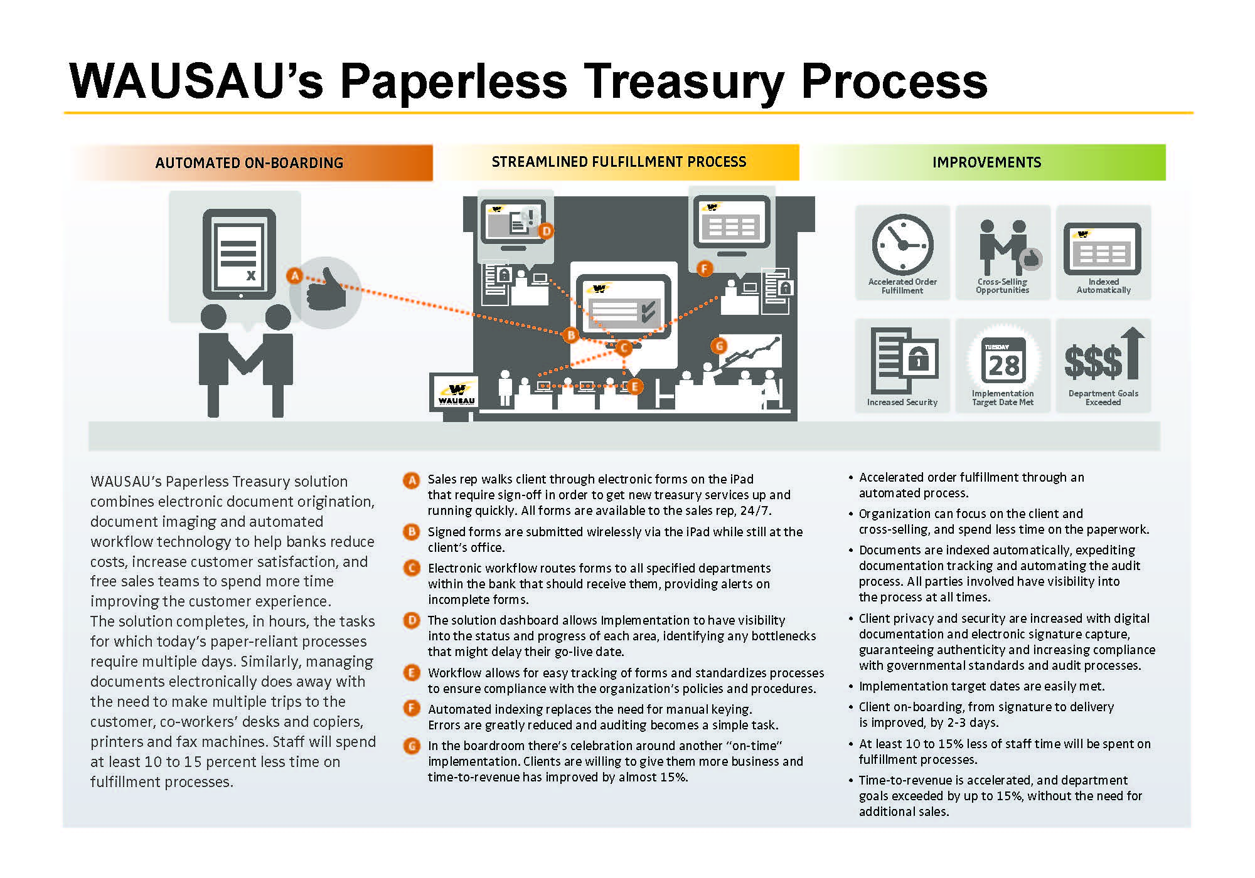
What should Paperless Look like?
A
The Sales Meeting: Improve Onboarding for new & existing clients.
B
+
C
Multi-task on Autopilot: Solution workflow eliminates redundancy.
D
Dashboard Deliverables: Simple, clear progression updates.
E
Consider Compliance Covered: Streamline the auditing process.
F
On-Demand Analytics: Improves communication between you & your clients.
G
Give Satisfaction, Gain Opportunity: Satisfied clients spur new potentials.

Slide 24

The Sales Meeting: New Client, Automated Onboarding
Collect data from new clients anytime, anywhere, with iPads & other mobile devices
Generate agreements automatically
  Standard agreement templates can be generated on-the-fly
  Complex/consolidated agreements can be sent back to a mobile device or made available online

Slide 25

The Sales Meeting: New Client, Automated Onboarding
Enter data once and apply to agreements & set-up forms
Sign & submit
  Sign & review documents on the iPad or online
  Instantly send secure documents to downstream processes

Slide 26

The Sales Meeting: Easier for Existing Clients
The benefits of going paperless extend beyond new clients
Current customers can sign-up for new services online
Data from their existing services can be applied to new services
Improve & enhance their Onboarding experiences
Make new impressions on established relationships

Slide 27


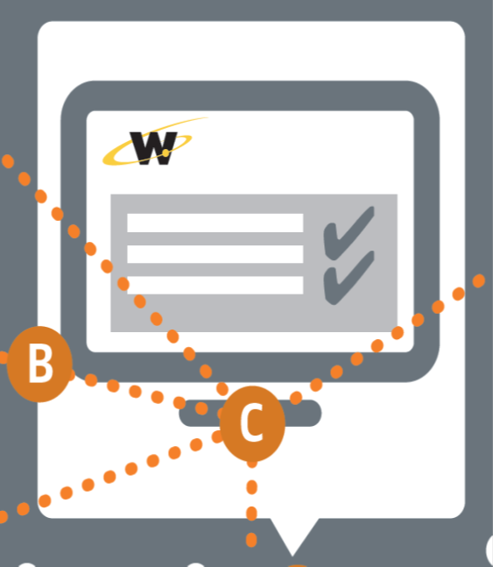
Multi-Task on Autopilot
+
Business rules ensure consistent processing – designed using 250+ predefined workflow rules without development
Repetitive tasks are eliminated through automation
Multiple implementation processes can occur in parallel

Slide 28

Multi-Task on Autopilot
+
C
Email/mobile integration for all workflow decisions
Forms designed & implemented without development
  Quickly deployed by business users including validation

Slide 29
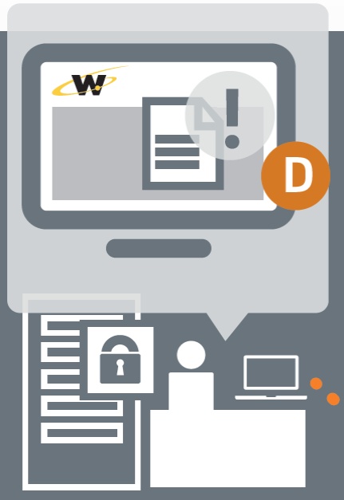
Dashboard Deliverables
D
A clean, simple dashboard view delivers:
24-7 access to your customer’s onboarding status & progression
Progress notifications can be sent internally and to the customer
SLA warning notifications can be sent to operations and Treasury Sales Officers

Slide 30
Compliance – Consider it Covered
E
Reduce audit efforts
Ensure all required signatures are captured
    Safeguard appropriate access to sensitive information
Easily identify customers who require updated agreements
Automate the collection/review/distribution processes

Slide 31
On-demand Analytics, Improved Communication
F
If problems do occur, surprises won’t
Identify potential bottlenecks that may delay the go-live date
Immediately notify clients and stakeholders of issues
Real-time information empowers clients & stakeholders to make informed business decisions
Exceptions, pipeline & productivity statistics generated automatically

Slide 32
Give Satisfaction, Gain Opportunity
G
Clients are involved & informed
More opportunities to cross-sell develop when Onboarding is:
  Easier
  Less work
  Delivered on-time
  Revenue is accelerated by up to 35%

Slide 33
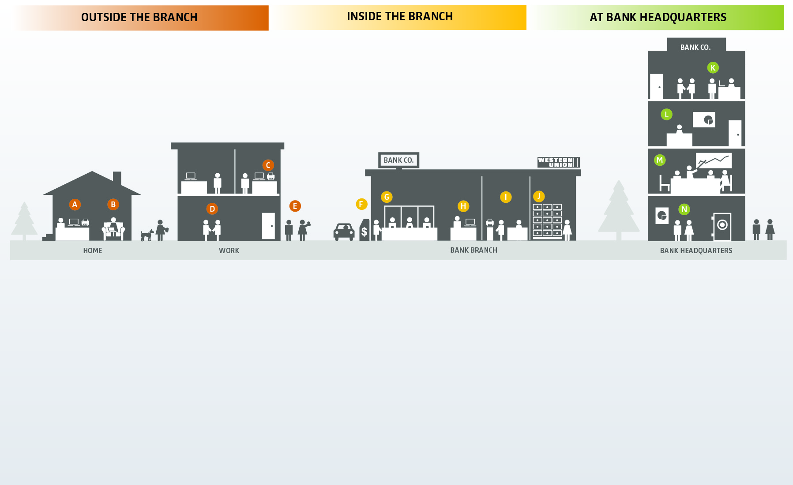
Beyond Treasury
CONSUMER RDC: Scan checks at home with a simplex flatbed scanner or all-in-one print/copy/fax machine.
Paperless: Remote signatures via iPad or Web for loans, new accounts, etc.
Merchant: Capture payments/deposits from the office with a high-speed MICR scanner, simplex flatbed scanner or all-in-one print/copy/fax machine.
Paperless: Remote signatures via iPad or Web for loans, new accounts, treasury, contracts, etc.
Mobile RDC: Deposit checks, on-the-go, through camera-equipped smartphones.
ATM: Transactions without envelopes, cash tickets or deposit slips.
Teller & Back Counter: Capture transactions for instant availability/tracking, while enabling simple balancing centrally or at the branch.
Loan and New Accounts Desk: Electronic signatures and automated capture accelerate business processes.
THROUGHOUT THE Back Office: Front line automation makes docs available immediately for retrieval while automated business rules reduce manual tasks.
Wire Transfers: Approve wires faster and maintain a full audit trail.
Human Resources: Apply digital signatures to legal documents/forms and eliminate the need for physical storage.
Finance: Store records digitally and integrate all information for easy approval and auditing.
Treasury Management: Apply electronic signatures to agreements online or on a mobile device, then route them and set up forms through workflow for approvals and implementation.
Wealth Management: Apply electronic signatures to documents while protecting and securing vital records for immediate availability and automated validation.

Slide 34
WAUSAU Paperless Treasury Discovery
Identify:
Corporate & departmental goals
Potential efficiency gains/process improvement opportunities
Duplicate data entry & redundant manual validation steps
Paper based float
ROI factors
Compliance & risk reduction opportunities
Visibility concerns

Slide 35
Case Study - $30+ Billion Institution
19 Sales Officers & 4 Regional Officers utilize SalesForce
  No downstream integration – data requires duplicate entry & opportunity for error
  Paper based signature processes for customers requiring “stacks” of paper
13 Analysts Averaging 3 Work Orders/Day
  Manually validate work order information from sales
  Manually create application to collect remaining information
  Manually tracking processes via Excel spreadsheets
Documents are printed 2-3 times throughout the process
Difficulty finding order status, requires calls or emails
Audit processes require manual review of documentation

Slide 36
Anticipated Results
75% reduction in paper generation & associated lease expenses
  Average cost of 3.5 cents/page, 30 pages/order 80% reduction in scanning & indexing activities for Synergy
  Electronic document import
Overall Onboarding process improvement of 35%
  Direct time to revenue improvement
  TMSA efficiency gains of 30%
    13 FTEs @ $16/hour ~ $120,000/year
50% reduction in manual audit activities
  Required documentation exists?
  Customer signatures on file?
  Identification of agreements that require modifications/new signatures
  Document preparation/collection activities
Notes:
Efficiency Gains:
Work order (electronic form) integration w/ SalesForce – 25% reduction
Elimination of manual tracking spreadsheet & data gathering meetings
Automatic generation of agreements/addendums – 50% reduction
Work order system validation (business rules) – 35% reduction
Risk levels – automatic approval routing
Document & data verification including Synergy documents
Select product automatic client setup – RDC (WAUSAU)
Commercial portal products also potential
Improved Communication between Departments & Customers:
Automatic system notifications internal & external
Status updates, profile/password notifications, implementation timeframes, etc…
Automatic escalation/reminder processes based on SLA rules
80% reduction in manual follow-up activities (phone calls, emails, etc…)
Real-time dashboard & reporting

Slide 37
Implementation Approach/Timeline
Detailed Project Discovery/Scope Definition: 3-4 Weeks
  Customer Requirements Document
  Customer Training; System Administration & Workflow
Integration Customization: 3-4 Weeks
  CRM Data Lookup
  Enterprise Content Management Solution Export
  Product Setup Formats
Solution Configuration: 4-6 Weeks
  WAUSAU Testing
User Acceptance Testing: 2-4 Weeks
  System Admin & End User Training
    Train the Trainer Training
  Solution Feedback & Modification
Initial User Group Go Live
Full Rollout
3-6 Month Project Review

Slide 38

Questions?

Slide 39


