Slide 1
NEACH Payments Group
The Intersection of Business Payments and Artificial Intelligence
Mark J. Dixon
Consulting Advisor NEACH Payments Group
02/21/24

Slide 2
Speaker
Mark J. Dixon, CTP, AAP, APRP, NCP
Consulting Advisor
Mark Dixon serves as a Consulting Advisor for NEACH Payments Group (NPG) and Vice President of Education for NEACH.
He has 20 years of experience in financial services and completed his MBA from Southern New Hampshire University where he also teaches part time as an Adjunct business online instructor.

Slide 3
Providing high quality services
Conducting ourselves with the highest level of integrity and mutual respect
About Us
NEACH Payments Group (NPG) is a wholly-owned subsidiary of NEACH, the New England Automated Clearing House Association. We work hard to create a payments landscape that is safe, compliant and sustainable.
We help organizations like yours—financial institutions, businesses and third-party providers—manage risk, drive improvements, maintain compliance and strengthen the bottom line. Our suite of audit, assessment and consulting services will help you do just that.
For years, we have provided hundreds of audits and risk assessments for financial institutions, businesses and third-party providers. What’s more, 90% of our customers come back year after year.
We would love to work with you.
Employing open and honest communication
Prioritizing responsibility to our partners and clients
Embracing a responsive and personal approach to every engagement.

Slide 4
What is AI?
01
Level set on the foundations of AI
Today’s
Integrating AI into Business Workflows
Agenda
02
Exploring how businesses are integrating AI into business functions.
Regulatory Movement
03
Diving into what regulators movements are happening in the AI front.
04
Workforce Considerations
Discussing the impact of AI on workforces and the future makeup of the business professional.

Slide 5
What is AI?

Slide 6
Artificial Intelligence
Computer science that allows machines to problem solve
Speech recognition, Computer Vision, Machine Learning, and Robotics
Deep Learning and the Artificial Neural Network
Narrow, General, Vs. Super AI
This Photo by Unknown Author is licensed under CC BY

Slide 7
Different Kinds of AI
Generative AI
Predicative AI
Generative AI creates something new based on what it as learned from past inputs.
Generative AI will use input prompts to create something in response.
ChatGPT is an example of Generative IA used today.
Predictive AI works with machine learning algorithms to make decisions and analyze data.
Predictive AI is excellent in automating business intelligence.
Predictive AI can be used to automate more routine functions

Slide 8
Examples of Generative AI Solutions
Tome
Yooz
AI presentation generator that uses prompts to create the presentation.
AI solution that uses prompts to generate invoices.
Copy.ai
Dall-E
AI text generator to develop product descriptions
AI image generator that creates images based on text descriptions

Slide 9
Predictive AI
Problem
What is the likely sales forecast going to look like in 2024?
Solution
Predictive machine learning algorithms connect to statistical historical data for the company and industry. New data is input related to sales variables.
Result
A sales forecast is generated for the company to use.

Slide 10
It’s early days still, but use of gen AI is already widespread
McKinsey Global Survey
Leading companies are already ahead with gen AI
McKinsey & Company, a leading research firm, released The state of AI in 2023: Generative AI’s breakout year.
AI-related talent needs shift, and AI’s workforce effects are expected to be substantial
With all eyes on gen AI, AI adoption and impact remain steady
10
www.neachgroup.com

Slide 11
The Dark Side of AI
We tend to focus on the positives of technology innovations like AI, but what of the negative implications. As much as businesses may innovate, so in turn will fraudsters.
increasing_threats_of_deepfake_identities_0.pdf (dhs.gov)
Deep Fakes
Cyber Attacks
Synthetic Identify Fraud
AI technology can create false audios, videos, and images that purport to be someone that they are not.
Phishing, BEC, denial of service, and even ransomware attacks are all being upgraded as AI technologies are integrated into and creates new fraud models.
AI technology can be used to help fraudsters create synthetic identities that appear to be legitimate but are a mixture of real and false information.

Slide 12
Integrating AI into Business Workflows

Slide 13
Examples
Business Uses for AI
Customer Experiences
Integration in messaging and customer contact points.
Workflow process improvement
Automation, analytics, idea generation. Etc.
What are businesses using AI for today?
Business intelligence
Improved data analysis.
AI is integrating into a variety of different workflows for businesses today.
Client/Customer Engagement
Increased customer touchpoint and user/buyer journey.
Fraud prevention
Speed, analytics, and control can detect, prevent, and respond to potential fraud and attacks.

Slide 15
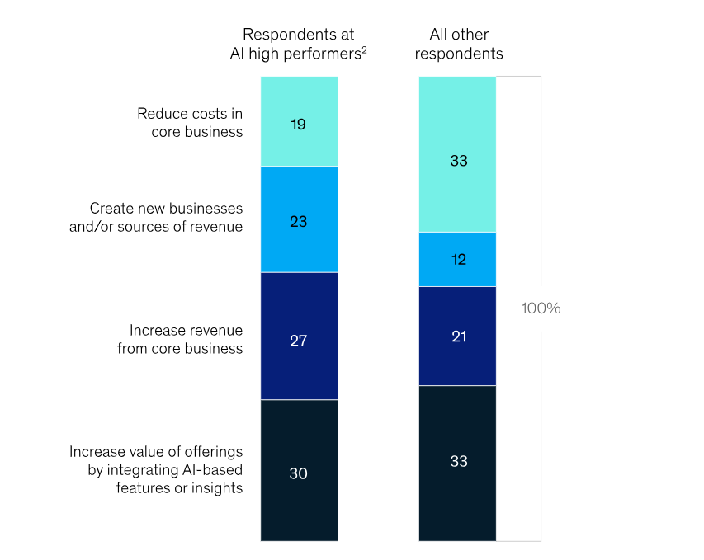
Top Objectives for Organizations’ Planned Generative AI Activities

Slide 16
AI and Payments
Using AI integrated solutions, companies can capitalize on a variety of factors such as those related to pricing discounts, reconciliations, and fulfillment automations.
Problem
Solution
Result
Manual processes
AI integrated solutions
Operational efficiencies

Slide 17
Machine learning tools can use historical data and complex algorithms for real-time data analytics. Traders then use AI predictions to design their long-term strategies. Algorithms may be customized based on risk tolerance and other trade preferences.
Foreign Exchange
17
www.neachgroup.com

Slide 18
Some of the AI Solution Providers for Businesses
Oracle Analytics
Hewlett Packard – AI Solutions
IBM Watson
Google Cloud AI
Microsoft Azure Machine Learning Studio
Amazon Web Services
Meta

Slide 19
Regulatory Movement

Slide 20
Executive Order on the Safe, Secure, and Trustworthy Development and Use of Artificial Intelligence
The Executive Order establishes new standards for AI safety and security, protects Americans’ privacy, advances equity and civil rights, stands up for consumers and workers, promotes innovation and competition, advances American leadership around the world, and more.
This Photo by Unknown Author is licensed under CC BY-SA

Slide 21
New Standards for AI Safety and Security
Require that developers of the most powerful AI systems share their safety test results and other critical information with the U.S. government.
Develop standards, tools, and tests to help ensure that AI systems are safe, secure, and trustworthy.
Protect against the risks of using AI to engineer dangerous biological materials
Protect Americans from AI-enabled fraud and deception by establishing standards and best practices for detecting AI-generated content and authenticating official content.
Establish an advanced cybersecurity program to develop AI tools to find and fix vulnerabilities in critical software
Order the development of a National Security Memorandum that directs further actions on AI and security

Slide 22
Protecting Americans’ Privacy
The President encourages congress to pass data protection laws
Protect Americans’ privacy by prioritizing federal support for accelerating the development and use of privacy-preserving techniques
Strengthen privacy-preserving research and technologies
Evaluate how agencies collect and use commercially available information
Develop guidelines for federal agencies to evaluate the effectiveness of privacy-preserving techniques

Slide 23
Supporting Workers
Develop principles and best practices to mitigate the harms and maximize the benefits of AI for workers
Produce a report on AI’s potential labor-market impacts, and study and identify options for strengthening federal support for workers facing labor disruptions

Slide 24
More About the Executive Order
Advancing Equity and Civil Rights
Standing Up for Consumers, Patients, and Students
Supporting Workers
Develop principles and best practices to mitigate the harms and maximize the benefits of AI for workers
Promoting Innovation and Competition
Advancing American Leadership Abroad
Ensuring Responsible and Effective Government Use of AI
FACT SHEET: President Biden Issues Executive Order on Safe, Secure, and Trustworthy Artificial Intelligence | The White House

Slide 25
CFPB and Federal Partners Confirm Automated Systems and Advanced Technology Not an Excuse for Lawbreaking Behavior
Tech marketed as “artificial intelligence” and as taking bias out of decision making has the potential to produce outcomes that result in unlawful discrimination
CFPB and Federal Partners Confirm Automated Systems and Advanced Technology Not an Excuse for Lawbreaking Behavior | Consumer Financial Protection Bureau (consumerfinance.gov)

Slide 26
McHenry, Waters Announce Creation of Congressional Bipartisan AI Working Group
The bipartisan AI Working Group will explore how artificial intelligence (AI) is impacting the financial services and housing industries, including the development of new products and services, fraud prevention, compliance efficiency, and the enhancement of supervisory and regulatory tools, as well as how AI may impact the financial services workforce.
McHenry, Waters Announce Creation of Bipartisan AI Working Group | Financial Services Committee (house.gov)

Slide 27
BIPARTISAN BILL TO ESTABLISH AI GUIDELINES FOR FEDERAL AGENCIES AND VENDORS
“As AI continues to develop rapidly, we need a coordinated government response to ensure the technology is used responsibly and that individuals are protected,” said Rep. Lieu. “The AI Risk Management Framework developed by NIST is a great starting point for agencies and vendors to analyze the risks associated with AI and to mitigate those risks. These guidelines have already been used by a number of public and private sector organizations, and there is no reason why they shouldn’t be applied to the federal government as well. I’m grateful to my House and Senate colleagues from both sides of the aisle for their partnership in this effort to promote safe AI use within the federal government and to allow the United States to continue to lead on AI.”
This Photo by Unknown Author is licensed under CC BY-SA

Slide 28
Workforce Considerations

Slide 29
Evolving Structure and New Skills
New skills needed
Training and Development
Supporting AI comes with the new skill sets needed.
New functions and processes result in the need for existing workers to update and develop new skills.
Process changes
Roles Change
AI will change processes, remove the need for certain functions, and update overall workflows.
As processes and structure change, the role of workers will also change.

Slide 30
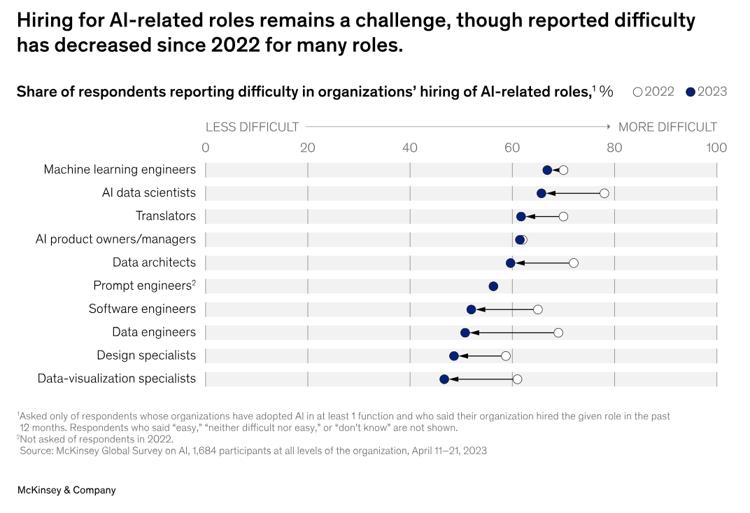

Slide 31
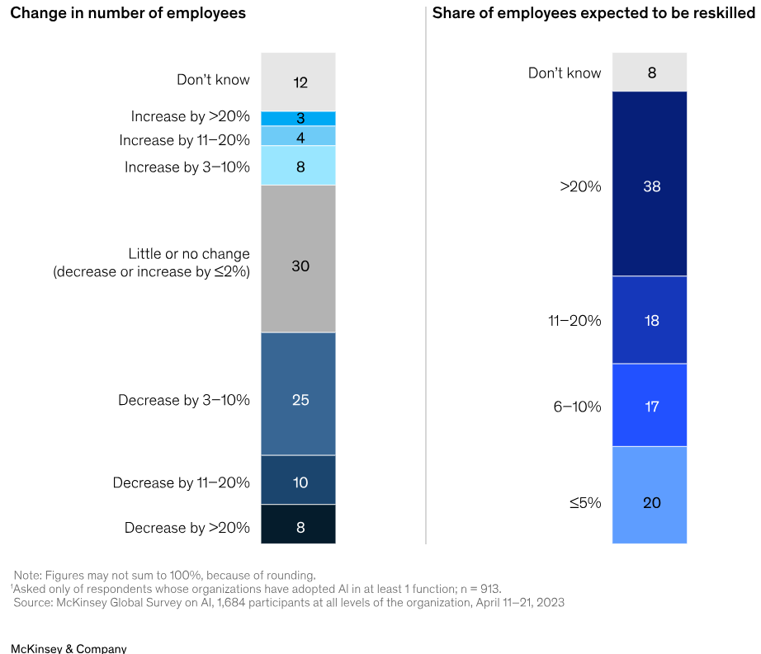

Slide 32
What about ChatGPT?
Ability to prompt the creation of essays, memos, letters, and even business strategies.
Technology is only as good as the database it is connected to.
It doesn’t always get it right.
Some responses are derivative and don’t add anything new.
This Photo by Unknown Author is licensed under CC BY-SA

Slide 33
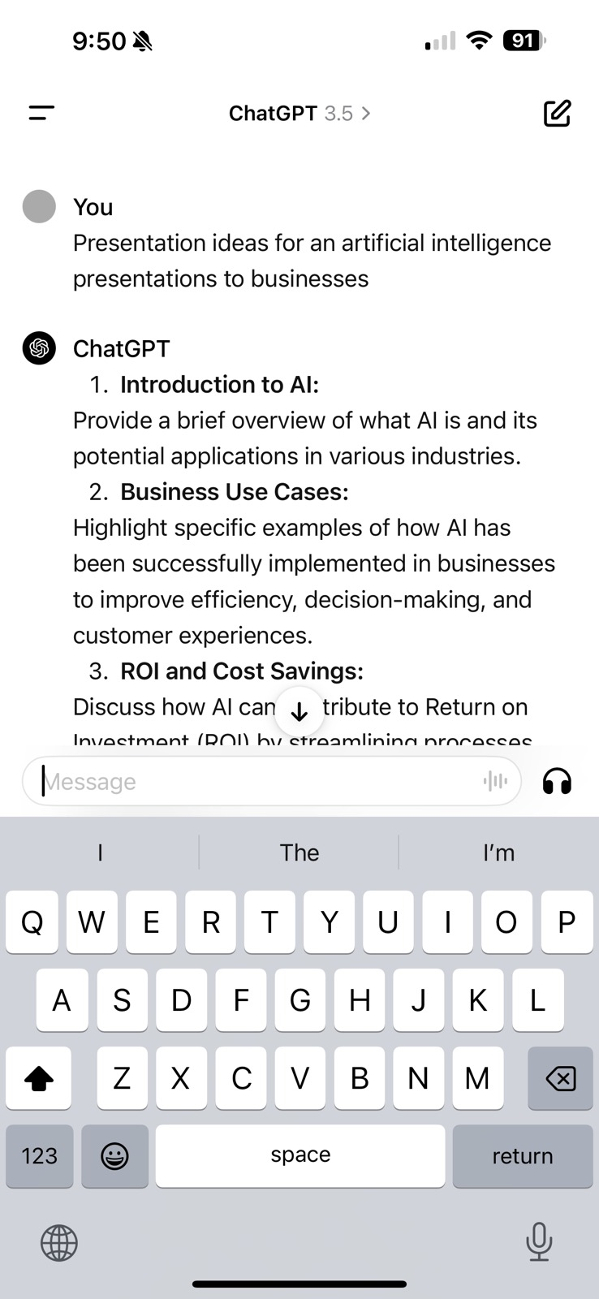
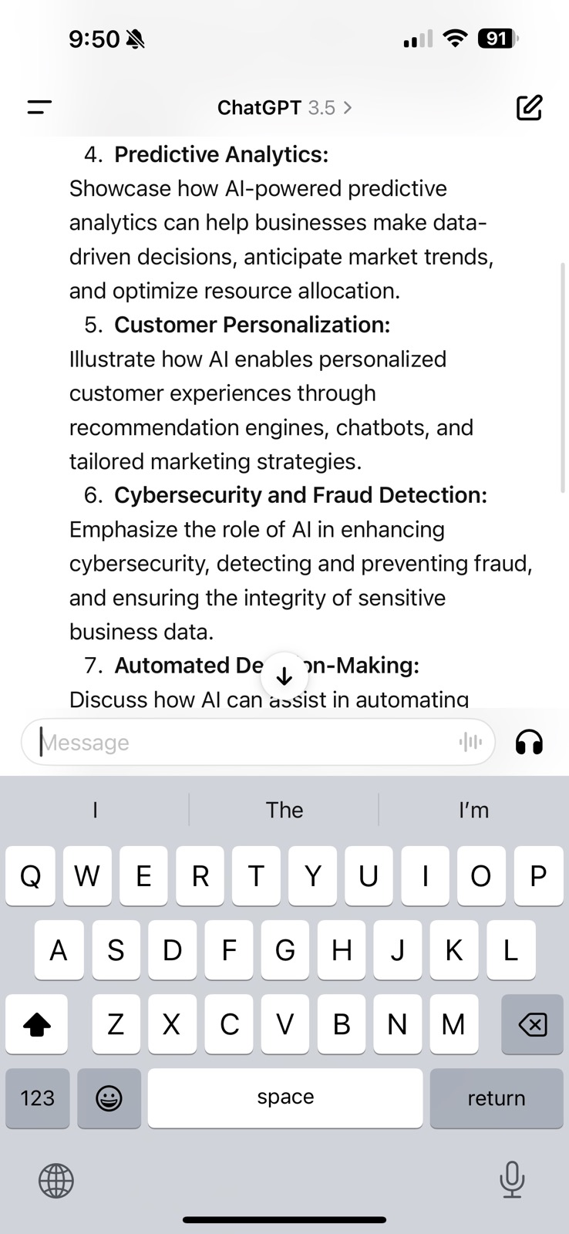
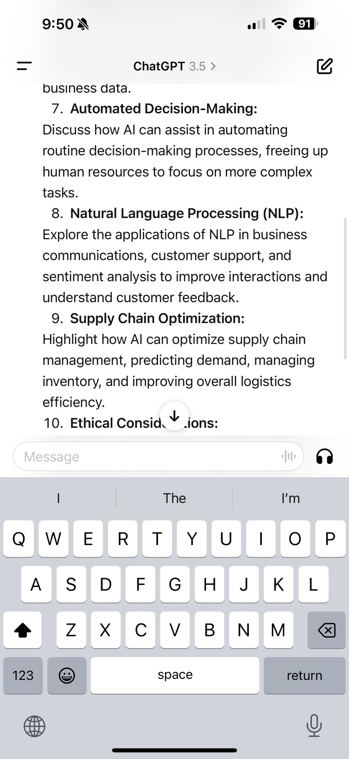
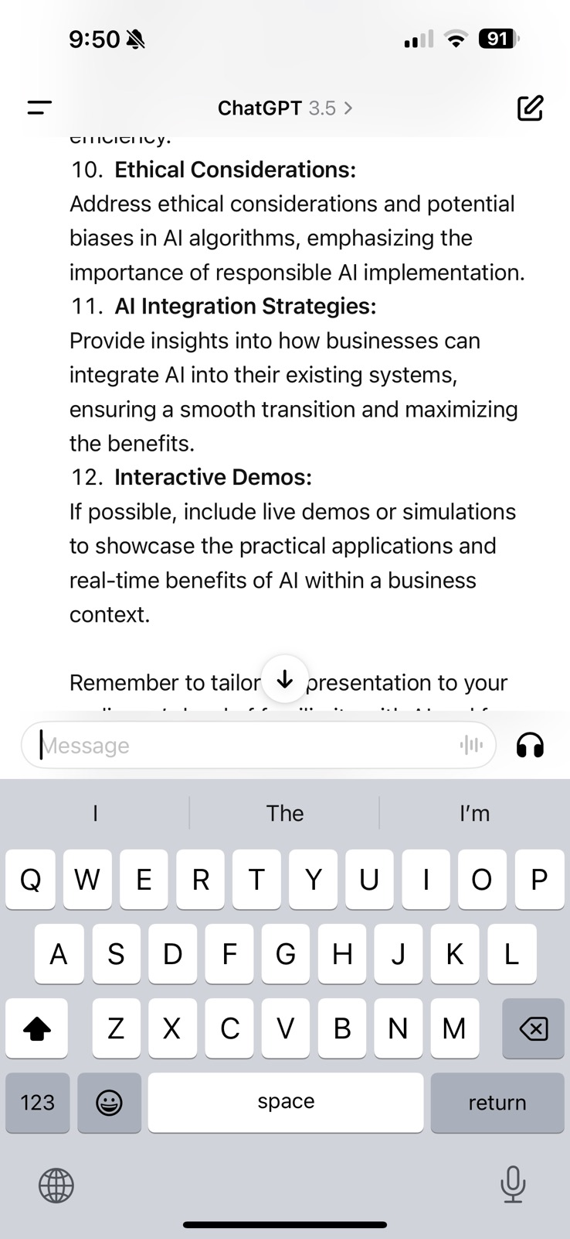
Prompting Chat GPT

Slide 34
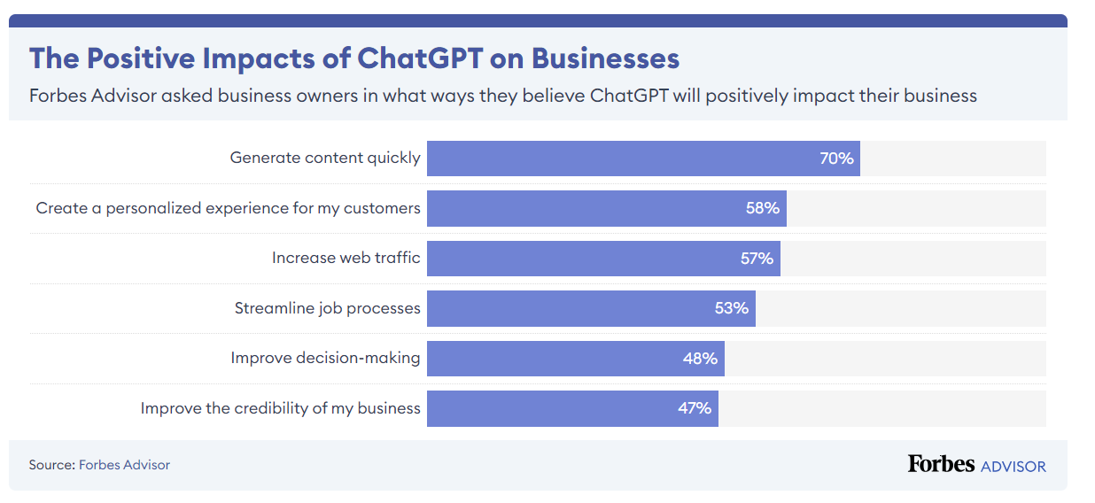

Slide 35
Ethics and Bias
AI is only as good as the learning algorithms and data scientist behind it
While AI may be used to automate and streamline, it should not be left unchecked
Businesses should establish quality control processes to ensure AI is decisioning correctly
Is there someone one the team with these skills?
This Photo by Unknown Author is licensed under CC BY

Slide 36
How Should Businesses Roll Out AI?
All Business Units and Staff
Targeted Approach
The power of AI can be instrumental in creating operational efficiencies by helping teams get started on projects, automate functions, and create efficiencies.
AI is expensive and businesses will need to look at the ROI before investing in AI.
Businesses will typically get the most back from investing AI in areas or R&D, innovation, and client experience.
If budgets are limited, a business should consider which areas will reap the most benefit from AI services.
This Photo by Unknown Author is licensed under CC BY-NC

Slide 37
Questions and Discussion

Slide 38
Contact Us
Thank You
781-321-1011
50 Burlington Mall Road
Suite 212 Burlington, MA 01803
mdixon@neachgroup.com
www.neachgroup.com

