Slide 1

The Future of Payments
STRICTLY PRIVATE AND CONFIDENTIAL
December 2016

Slide 2
Agenda
Topic | Page
Trends, Insights, Implications | 2
Banks and Fintechs: Collaboration and Innovation | 5
Millennials: Driving and Embracing Payment Technology | 6
Payment Ecosystem Changes Federal Reserve Faster Payments Initiative Same-Day ACH New Payment Rails Remittance Coalition | 7 8 9 12
Blockchain | 13
Looking Ahead | 14

Slide 3






Payments trends and the move to electronic are influencing Fintech investment
Number of transactions per year, in billions
Change in payment type¹
  9.65% annual growth rate in number of ACH transactions
$2.33 to $4.52 (trn)
  8.80% annual growth rate in number of card transactions
$41.15 to $26.03 (trn)
  -6.87% annual decline rate in number of check transactions
$24.11 to $48.41 (trn)
Continued shift to mobile
Alternative forms of payments increase
Bill payments
  US Consumers making mobile payments doubled from 2011 to 2015,² going from 12% to 24%
  The number of payment transactions in PayPal accounts increased 23% annually from 2013 to 2015³
  Bill payments are changing form and impacting the customer experience
¹Source: 2013 Federal Reserve Payments Study
²Source: Federal Reserve Consumer and Mobile Financial Services 2016 Report
³Source: PayPal 2015 10K
Notes:
Speaker Notes
Although the shift to electronic from paper checks is a well known trend at this point, it can be framed as a driver/cause of the increasing fintech investment detailed on the next slide
Shift to mobile – the percentage of consumers making mobile payments has doubled since 2011 according to a study by the Fed.
Alternative forms of payment – PayPal used as an example. Venmo payments have been grown also - $1 billion was transferred on Venmo in January 2016, which is 2.5x more than in January 2015.
Bill Payments – the last point strives to create a connection with the audience and show how applicable these trends really are.

Slide 4


The Fintech ecosystem has been rapidly expanding over the past 2 years
Global FinTech Investment in the Past 5 Years¹
2016 Q1 saw $5.3 billion invested in fintechs globally, a 47% increase from Q1 2015 ¹
  Currently, fewer regulatory hurdles for fintechs than for large financial institutions
SoFi
Zhong An Online Insurance
Zenefits
Affirm
  Fintechs are providing a robust user experience, but still depend on banks for back end transactions and rails
Global Deal Volume
¹Source: Accenture, Fintech and the Evolving Landscape
  Focus on Lending, Payments, and Retail segments of fintech
  Maturation of the Lending, Payments, and Retail spaces, shift to other segments such as B2B Payments
  44% of 2015 fintech investment has been in collaborative firms¹
  Fintechs viewing banks and companies as partners rather than competitors, which presents opportunity
Notes:
Speaker Notes:
Top deal notes
SoFi – SoFi is a marketplace lender offering mortage, student loan financing, and other loans, and is based in San Francisco.
Zhong An Online Insurance – China’s first online-only insurer, backed by Alibaba’s financial-services affiliate
Zenefits - offers cloud-based software as a service to companies to manage their HR
Affirm - offers lending services for shoppers at fair rates
The value of global fintech investment in 2015 grew by 75% to $22.3bn – this outpaces venture investment as a whole which only grew 29% in 2015.
Despite the increase in global investment, there are signs that the fintech industry is beginning to reach a new level of maturity, such as:
Increase in larger deal sizes
3 fintech hotspots, New York, Silicon Valley, and London, have seen slowdowns in growth, although Austin, Stockholm, and Mumbai have picked up.
In Q1 2016, fintech companies in APAC received more than 50% of all global investment, so APAC was a strong driver of the 2016 number so far.
Focus on Lending and Retail
44% of global fintech investments in 2015, compared to 29% in 2014, have been in collaborative fintechs who seek to enhance to the position of existing institutions
An increasing number of fintechs, not able to compete with established financial institutions, will view banks as partners
Expanded opportunity for banks and other companies to collaborate with fintechs

Slide 5
Fintech disruption and collaboration span all areas of the financial industry
VC FinTech Financing Activity by Product Segment
Companies
Segment
Total investment: ~$17.1B
29 | Consumer Banking
25 | Financial Research
118 | Equity Financing
62 | Institutional Investment
49 | Crowdfunding (Non-Investment)
41 | Remittances
78 | Banking Infrastructure
80 | Digital Wealth Management
124 | Personal Finance
45 | Business Tools
78 | Payments (Acquirer - Online/Electronic)
42 | Payments (Issuer/Consumer)
81 | Payments (Acquirer - POS)
98 | Lending (Business)
97 | Lending (Consumer)
Payments and Lending constitute ~60% of all VC investment
Payments: ~$3.8B
Lending: ~$6.7B
Source: Venture Scanner (multi-year information not reconciled with CB insights annual fund raising data)
Note: Not exhaustive. Data does not include Crypto companies; estimated to have ~$0.3B by 107 startups
Notes:
Main takeaway from this page – Payments and lending are the largest segments of fintech. However, be aware that this is VC investment only and does not include bank investment and other investments.
The payments and lending spaces continue to dominate.
$462mm in blockchain funding from VC firms between September and January 2015
This information is a multi-year look at the fintech sub-sectors that are being funded by venture capital and private equity

Slide 6




Embracing the changing environment
J.P. Morgan’s Response
LevelUp
Apple Pay
OnDeck
Kensho
  Move from venture capital investment to bank investments
  Thinking for short term fixes as well as long term innovation
  + Engagement with more than 300 emerging technology firms in 2015
Invest
Collaborate
How Banks Embrace Financial Technology
  Shift from competition to collaboration
  New opportunities for smaller banks who lack capital to build solutions in-house to leverage fintech innovation
J.P. Morgan’s Response
Recently invested in:
Avant
Digital Asset Holdings
Motif Investing
Build
J.P. Morgan’s Response
  Overall, banks spent $50 billion in 2015 on new in-house technology development
  Banks planning significant boost in tech spending for 2016
  + Other Industry leading products
  + Engagement with more than 300 emerging technology firms in 2015
  40,000+ technologists
  $9.4bn total tech budget
Robotics Center of Excellence
Notes:
Invest (can also be viewed as partnerships)
In 2013, 41% of global fintech investment came from VCs – this is down to 34% in 2015. Banks are investing more and more heavily
In order to achieve both short and long term success, banks must not only invest in easily adoptable technologies but make other investments in innovation as well.
Investment in several emerging and legacy fintechs to achieve efficiency and provide increased value to clients
The Financial Solutions Lab at JPM is a $30 million, five-year initiative with a series of competitions to identify, test and expand the availability of promising innovations that promote financial health
JPM Deal Notes
Avant – $20mm investment for 1%, partnering with Avant to collateralize consumer loans
Digital Asset Holdings – $7.9mm investment for 5%, partnering with Digital Asset Holdings for syndicated loan settlements
Motif Investing – $10mm investment for 4%, enabling individuals to invest and participate in IPO
Collaborate
JPM Deal Notes
LevelUP – goal is enabling Chase Pay features and functionality
OnDeck – building new Chase lending product that will be launching in 2016 for small-dollar loans to our small-business clients. Partnership offers upside for both parties
Kensho – providing automation back-testing on correlation of events and market data that provides some talking points for client sales
Apple Pay
Cross-LOB Fintech Governance forum for engaging and strategizing with fintechs.
Collaborative fintech investments in New York accounted for 83% of all fintech funding in 2015, up from 37% in 2010.
Regional banks lacking the budget to build advanced technology in-house have the ability to partner with fintechs for new solutions, effectively reducing the barriers to entry in the space.
Build
Most banks are planning significant boosts in technology spending for 2016.
Data analytics, security, and mobile/online banking are some of the areas where substantial increases in spending are projected.
Picture is of JPM’s new 125,000 square-foot technology hub on Manhattan's West side
Financial Solutions Lab is a $30mm, five-year initiative managed by the Center for Financial Services Innovation (CFSI) to identify, test, and expand the availability of promising innovations that help Americans increase savings, improve credit and build assets
Robotic Process Automation – Robotic process automation will be used for repetitive and predictable tasks, allowing staff to perform more meaningful work. The Robotics Center of Excellence works to develop and evaluate new robotics apps called BOTs.

Slide 7
The Millennial Impact
 | Millennials | GenXers | Boomers
Used a bank’s mobile app | 67% | 55% | 33%
Used a bank’s website or online portal | 78 | 75 | 67
Used the mobile app to transfer money | 26 | 19 | 8
Used the mobile app to pay a friend or family | 21 | 12 | 5
Source: 2015 Chase Digital Adoption Survey
Chase’s Digital Adoption Survey shows a high percentage of millennials using mobile apps and websites for banking and to transfer money
Statistic
Insight
75% of the workforce will be made up of Millennials by 2030¹
  Millennials are highly tech savvy and grew up with internet and mobile devices, and as more and more become decision makers in businesses, the shift to electronic B2B payments could increase
>50% of Millennials are using non-traditional payment companies like PayPal and Venmo²
  User friendliness and customer experience is driving Millennials toward non-traditional banking options, so companies must be willing to adapt
¹Source: US Bureau of Labor Statistics
²Source: FICO Millennial Insight Report

Slide 8
Federal Reserve Faster Payments
The Federal Reserve has identified 5 strategies that would improve the U.S. payment system
Stakeholder Engagement
Faster Payments
Payment Security
Payment Efficiency
Enhanced Federal Reserve Services
  500+ members engaging on Faster Payments and Secure Payments Task Forces
  Implementation of ISO 20022 for wire transfer and ACH
  The Fed has created many ways for stakeholders to stay informed and offer feedback
  B2B, B2P, P2P, and P2B payments all in scope
  Federal Reserve is exploring options to
    Evolve ACH
    Evolve ATM/PIN debit infrastructure
    Direct clearing over public IP networks
    Build new infrastructure for retain payments
  Faster Payments Task Force established in 2015
  Reduce fraud risk and advance the safety, security, and resiliency of the payment system
  Payment Identity Management work group is addressing the lack of universally accepted methods of establishing and confirming the identity of payers and payees
  Secure Payments Task Force focusing on data protection, information sharing, law coordination
  Attain better end-to-end efficiency for domestic and international payments
  Remittance Coalition creating B2B directory, which seeks to allow businesses to make more electronic payments to vendors, suppliers, and other payees
  ISO 20022 as a standard
  Hours of the National Settlement Service were expanded in 2015
  FedACH SameDay Service will support implementation of a universal Same Day ACH
Faster Payments final payments report to be released Q1 2017
J.P. Morgan’s Engagement
  J.P. Morgan is a member of the Federal Reserve Faster Payments Task Force
  Commitment to efficient change
  Preparing to adopt and support new payments rails that are created
Notes:
Fed Faster Payments Timeline (many other smaller initiatives and research studies that are subsets of the larger program have also been undertake in the last few years)
2013 – the Fed publishes “Payment System Improvement – Public Consultation Paper” which set the direction for industry-wide payment improvements.
2015 – Task forces established and a more detailed outline of the strategies and ask.
Notes (from Tom Bianco, who represents JPM on Fed Faster Payments Task Force)
The Federal Reserve Faster Payments Initiative is not a single form of payment rails – the Fed wanted to engage all the players in the payments industry and encourage them to build a faster payments system. Many tech companies submitted proposals to the Fed for faster payments builds, McKenzie is analyzing all of these for the Fed.
The Fed’s end game is to create a comprehensive effectiveness criteria that will highlight the key elements of a ubiquitous faster payments system. The Fed likely will not endorse one solutions over another if multiple are built.
The Fed wanted to push the industry to develop faster payment solutions

Slide 9
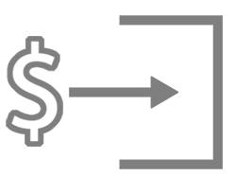
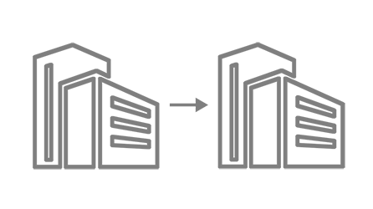

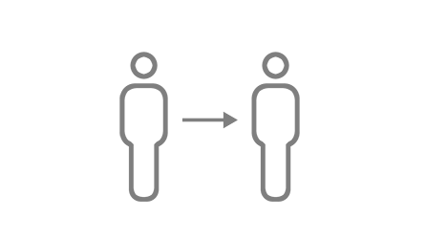

NACHA – ACH Same-Day
1.
2.
3.
Sept 2016
Sept 2017
March 2018
ACH Credits
A.M. & P.M. Transmissions
5 P.M. ET Settlement
ACH Credits and Debits
A.M. & P.M. Transmissions
5 P.M. ET Settlement
ACH Credits and Debits
A.M. & P.M. Transmissions
Faster Funds Availability
Builds functionality over time, adding value to end-users with each step.
  Client Use Cases
Payroll
Business-to-business
Bill Pay
Person-to-person
Funding
Notes:
Client Use Cases - details
Payroll – emergency payroll, hourly/temporary employees
Business-to-business – due date/late invoice payments, just-in-time payments
Bill Pay – Late bill or due date payments
Person-to-person – bill splitting, replacing non-FI P2P services
Funding – loan disbursements, merchant funding for card settlement
J.P. Morgan Response to Same Day ACH
J.P. Morgan will support Same Day ACH Origination for all clients
Existing ACH originators will automatically be enabled to initiate Same Day ACH transactions
New client-focused file deadlines will be established and communicated once finalized
Robust reporting of transaction information

Slide 10
New Payments Rails
 | TCH | EWS | Networks | Book Transfer | Digital Currency
Name | Faster Payments | clearXchange | Visa OCT/ MC Send | E.g. Earthport | E.g. Bitcoin
Attributes Irrevocable Real-time Alias driven | ✓ ✓ 3rd parties | ✓ ✓ ✓ | ✓ ✓ 3rd parties | ✓ | ✓ ✓ Wallets
Use cases P2P B2C Bill Pay B2B | (ISO 20022) ✓ ✓ ✓ | ✓ ✓ ✓ | ✓ ✓ ✓ | ✓ | ✓ ✓ ✓ ✓
Pros | 20022 messaging; x-border | Integrated with 7 major banks | Ubiquitous, including x-border | Limited to low-value | Low cost in theory; x-border
Cons | Still building; cost? | 60% 2016 real-time ubiquity; no x-border | Content limits; 3rd parties provide alias | Limited to x-border use cases | Lack full AML compliance
When? | 2017 | 2016 | 2016 | 2016 | 2016
Notes:
TCH – (more info on the following page) – JP Morgan is a founding member. The maximum payment amount, at least initially, will be $25-50K. These payments will be able to be made more efficiently and cheaper with faster payments. ISO as a messaging standard
EWS – (more info ion page 12) – 7 out of the 10 top banks are involved in this. Will lead to bill pay with real time availability. If the payee is a consumer, they will be able to pull funds out of the ATM right away.
Networks – This shows a move away from traditional card. Facebook is using Visa OCT for its P2P service
Book Transfer – Earthport seeks to make an international wire function more like a domestic low value faster payment.
Digital Currency – This is not a threat in the next 3-5 years, but potentially could be afterwards. JPM could not run our volume over bitcoin rails, it is too vast.

Slide 11
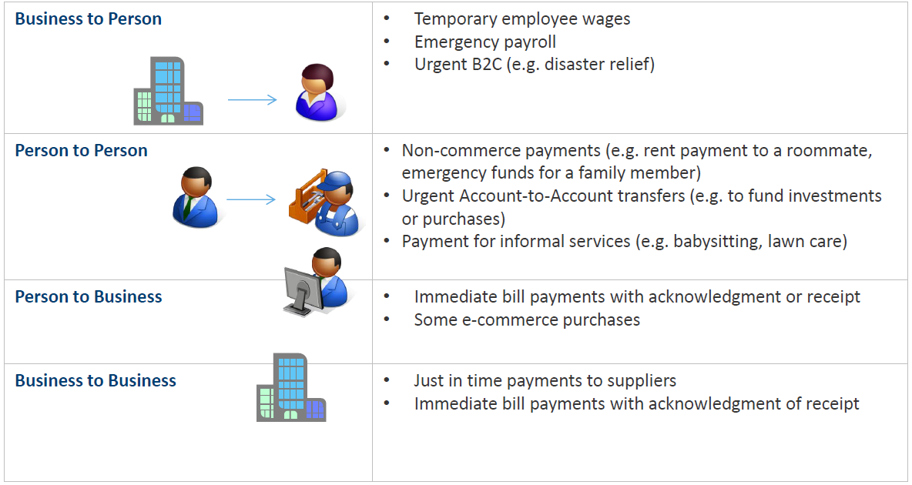
The Clearing House – Real time payments
Faster Payments
  TCH Vision for the Future of US Payments System:
    Provide an end user experience and functionality that fulfills needs that are not adequately met by existing payment systems.
    Set risk management and fraud protection standards that are appropriate for the essential characteristics of a payment (speed, value, debit or credit, etc.) rather than the clearing system or form of the payment.
    Be an open, global-ready platform.
    Provide economic models that ensure that all service providers in the payment system can expect a return on initial an ongoing investment.
The Clearing House real-time system will address needs across many use cases
Notes:
Faster payments would be the first new payment rail in the US in the past 30-40 years.

Slide 12

Early Warning Systems and clearXchange
P2P
  Early Warning acquired clearXchange in December 2015, and clearXchange launched real-time payments in 2015, covering over 100 million online banking customers.
  Benefits: Consumers can pay bills anywhere, anytime, can have cheaper and more convenient access to funds, and better security
  Beginning in March 2016, Early Warning began processing P2P transactions through the clearXchange network for a number of banks
  JP Morgan, Bank of America, and US Bank joined together in June 2016 to allow customers to transfer money between the institutions in real time
  Chase QuickPay processed $20 billion in payments in 2015, which was more than double any Fintech. The number is expected to rise 40% in 2016
B2C
  Corporate Quick Pay
  Evolution into bill payments and refund with real-time availability
Account Validation
  Allows confirmation of the existence and validity of an account upon receiving a check payment at a branch. EWS is the preferred and only partner of NACHA for account validation services
Notes:
JPM joined clearXchange about 3-4 years ago.
Originally, about 90% of Chase QuickPay Volume was Chase customers to other Chase customer. Once we joined clearXchange, our volume with BofA and Wells went way up.
Compared to Venmo, a P2P competitor – our transaction size limit is much higher because of stronger AML, we have real time to bank accounts payments.

Slide 13

Remittance Coalition and the Federal Reserve
Remittance Coalition
  A group of organizations working together to promote use of electronic B2B payments and electronic remittance data exchanges
  The Coalition includes over 240 representatives from small and large businesses, industry associations, financial institutions, software vendors, payment processors and service providers, standards developers, and others.
Why Address Remittance Data?
  B2B check volume is declining, but not as fast as consumer check volume.
  When remittance data flows with an electronic payment, it may be separated from the notification of the payment. Because of the lack of a simple, easily adopted standard, the receiver may not have sufficient information to reconcile it with the right payment
B2B Directory Project
  The B2B Directory is a public utility that enables payees to register either Electronic Payment Identity (EPI) and allows payers to retrieve it for simplified electronic payments.
  Benefits to businesses – Reduces time spent manually entering vendor details, boost security, reduces check usage
  Goal: To enable business payers of all sizes to make more electronic payments to vendors and all payees
Notes:
Remittance Coalition Timeline
2013 – Remittance Coalition begins support for a B2B Directory Work Group.
2015 – Fully defined data model for B2B directory, grew the number of Vendor Forum members, and continued to progress
2016 – Focus is to Establish Directory Association and take the B2B directory into the pre-market phase
The B2B Directory is the primary objective of the Remittance Coalition.
It is a directory for bill payments – similar to when an individual pays a bill to Verizon for example and the company will automatically populate in the online bill pay when you enter “Verizon” rather than requiring an account number and routing number.
Businesses will not have to enter in the details for their vendor payments as they should populate once they type in the name, therefore reducing the risk of typing an incorrect account number as well as reducing the time and effort spent doing this. Also, this will encourage more electronic payments, which are more efficient and save the business money.

Slide 14







Blockchain
  Blockchain is a technology that maintains a database between many participants without the need for a third party or reconciliation. It is a secured distributed ledger that holds a constantly expanding list of transaction record that are protected from modification and tampering.
1
Entity A wants to send funds to Entity B
2
The transaction is denoted online as a block
3
The block is broadcast to every member in the network.
Most banks prefer a closed system checking all details and controlling access via invitation, like the one displayed here, because of the increased security. Bitcoin, on the other hand, is an open source system.
Entity A’s Computer
4
Those in the network approve the transaction is valid before it is recorded, in a “chain” of computer code.
5
The block is then added to the chain, which shows a clear record of all transactions
6
The funds move from Entity A to Entity B
Entity B’s Computer
Potential for Disruption
Additional Use Cases
JP Morgan’s Actions
  Settlement speed improvement
  Increased transparency
  Simplifies cross-border payments
  Lower costs - $20bn in savings
  No need for a third party or reconciliation
  Proof of ownership and a marketplace for digital assets
  Improving anti-counterfeit
  Ledger services for a wide array of financial assets
  R3 consortium of 45 financial companies
  Digital Asset Holdings investment
  JP Morgan’s test of blockchain technology with 2,200 clients
  JP Morgan’s Juno blockchain project unveiled in March
Source: Financial Times
Notes:
What is Blockchain?
Blockchain is a technology that maintains a database between many participants without the need for a third party or reconciliation
It is a secured a distributed ledger that holds a constantly expanding list of transaction records that are protected from tampering and modification by network validation and cryptographic security.
$462mm poured into Bitcoin sector in January-September 2015, double the amount from 2014, according to Coindesk
Potential for Disruption
Settlement Speed – currently, the settlement process between two banks to complete a transaction is about one business day – with blockchain, the time is 7-10 seconds.
Transparency – the blockchain creates a complete, auditable, and unchangeable record of all activity and transactions
Cross Border Payment Simplification –
Lower Costs – Banks believe that blockchain could cut up to $20bn off costs and transform the way the industry works, per Financial Times. The technology could cut banks’ infrastructure costs for cross-border payments, securities trading and regulatory compliance by $15bn-$20bn a year from 2022
There is no cost to access the bitcoin network, and even if subsequent blockchain networks do have fees, the transactions fees will likely be much lower than they currently are
JPM Actions
R3 is a blockchain technology company leading a consortium of 45 financial companies including JP Morgan
Digital Asset Holdings is a blockchain tech company providing settlement and ledger services for financial assets, with Blythe Masters as CEO
In early 2016, JP Morgan tested a blockchain program for about 2,200 clients on U.S. dollar transfers between London and Tokyo. The goal is to give clients fast turnaround times and reduce risk.
Juno project, unveiled by JPM on March 3, is working on the development of an open source blockchain

Slide 15
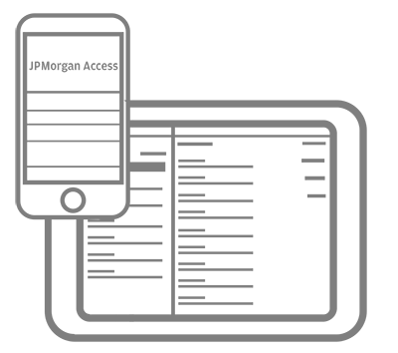





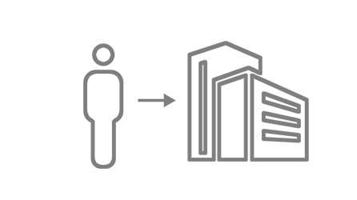


General investments
Payment technology is evolving at a rapid pace and J.P. Morgan is committed to investing in technology and the future of payments
Robotics & automated workflow
API enhancements
Rich POS Experience
A.I. and machine learning
1 - 2 Years
3 - 5 Years
6 - 10 Years
Payment disruption
moves from retail to B2B
Continued migration
from physical to online
Robust integration
making the actual
payment an afterthought
Digital Systems such as blockchain
In 2015, J.P. Morgan spent $9 BILLION+ in Technology – 1/3 of spend on investments¹
  Electronic Payments
  Efficiency
  Fraud
  Specialized industries
  ¹page 11 of the Firm Overview discussion presented at JPMorgan Chase’s “Investor Day” on February 23, 2016

Slide 16
JPMorgan is a marketing name for certain businesses of JPMorgan Chase & Co. and its subsidiaries worldwide (collectively, “JPMC”). Products and services may be provided by commercial bank affiliates, securities affiliates or other JPMC affiliates or entities.
This document was prepared solely and exclusively for the benefit and internal use of the party to whom it is directly addressed and delivered (the “Company”) in order to make a preliminary presentation to the Company regarding certain products or services that might be provided by JPMorgan. This document and any related presentation materials are for discussion purposes only and are incomplete without reference to, and should be viewed solely in conjunction with, a related oral briefing provided by JPMorgan. This presentation does not constitute a commitment by any JPMC entity to extend or arrange credit or to provide any other services. The Materials and oral briefing (collectively the “Information”) contain information which is confidential and proprietary to JPMorgan and may only be used by the Company for the purpose of evaluating the products and services described in the Information and may not be copied, published, disclosed or used, in whole or in part, for any other purpose other than as expressly authorized by JPMorgan.
In preparing the Information, JPMorgan has relied upon and assumed, without independent verification, the accuracy and completeness of information available from public sources or provided to it by or on behalf of the Company. JPMorgan does not guarantee the accuracy, completeness or reliability of that information. JPMorgan’s opinions and estimates contained herein reflect prevailing conditions and our views as of this date, which are accordingly subject to change, and should be regarded as indicative, preliminary and for illustrative purposes only. Our analyses are not and do not purport to be appraisals of the assets, stock, or business of the Company or any other entity.
The Information is not intended and shall not be deemed to constitute or contain advice on legal, tax, investment, accounting, regulatory, technology or other matters on which the Company may rely, and the Company should consult with its own financial, legal, tax, accounting, compliance, treasury, technology, information system or similar advisors prior to entering into any agreement for JPMorgan products or services. The Company is responsible for its own independent assessment as to the cost, benefit, suitability and appropriateness of any products or services it obtains from JPMorgan. JPMorgan makes no representations as to the actual value which may be received in connection with any JPMorgan product or service or the legal, tax, or accounting implications of consummating any transaction contemplated by the Information.
The Information does not purport to set forth all applicable terms or issues and are not intended as an offer or solicitation for the purchase or sale of any financial product or service or a commitment by JPMorgan as to the availability of any such product or service at any time. JPMorgan products and services are subject to applicable laws, regulations, service terms and policies of JPMorgan. Not all products and services are available in all geographic areas or to all customers. Eligibility for particular products and services is subject to satisfaction of applicable legal, tax, risk, credit and other due diligence, JPMorgan’s “know your customer,” anti-money laundering, anti-terrorism and other policies and procedures.
All trademarks, trade names and service marks appearing in the Information are the property of their respective registered owners.
© 2016 JPMorgan Chase & Co. All rights reserved.

